Slide 1

Google Trends for Stock Price Prediction
Jack Olson

Slide 2
Outline
Introduction
Predicting Stock Prices With and Without Google Trends
History of Google Trends as a Stock Trading Tool
Conclusions

Slide 3
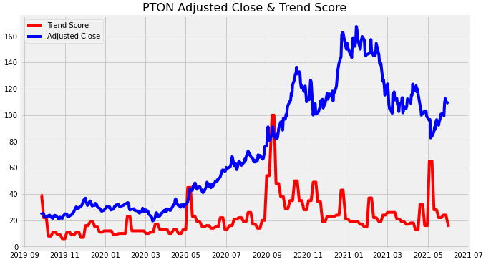
Problem Statement
Could using Google Trends improve the prediction of stock price changes?

Slide 4
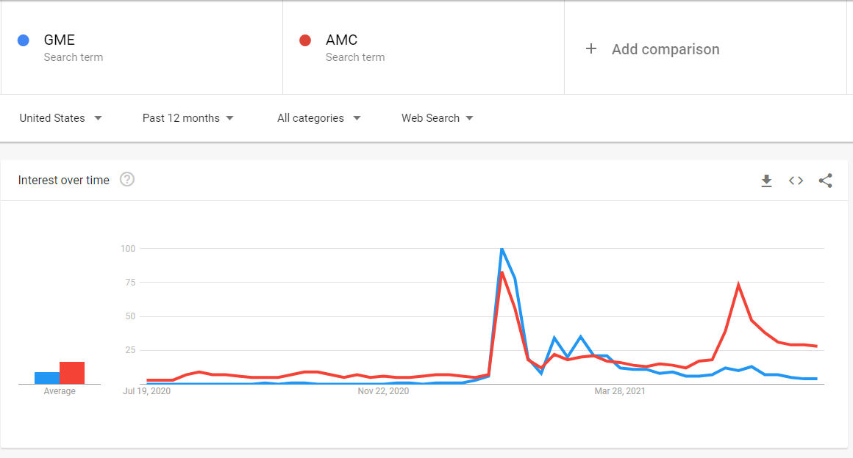


What is Google Trends?
Google Trends uses graphs to compare the search volume of different queries over time. - Wikipedia

Slide 5
Modeling
ARIMA
ARIMA w/ Exogeneous Variable (GT)
Vector Autoregression (VAR)

Slide 6
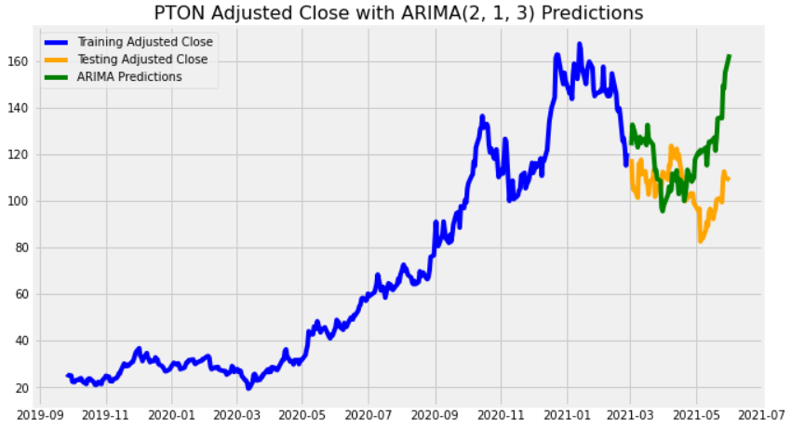
ARIMA Modeling
ARIMA uses historical prices to predict future prices
ARIMA is a good baseline model because it is simple and can be used for any stock

Slide 7
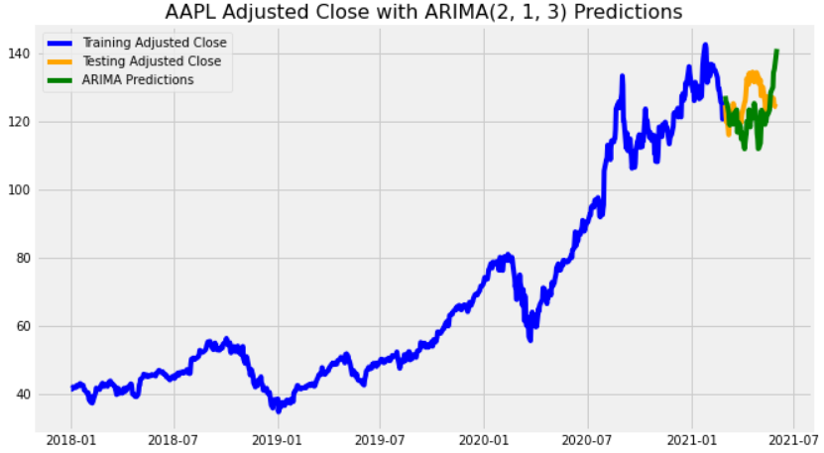
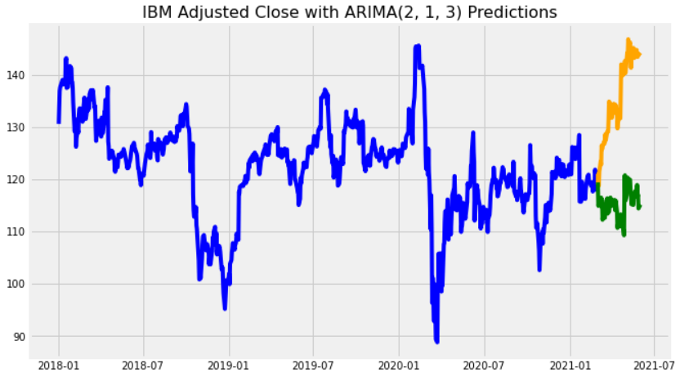
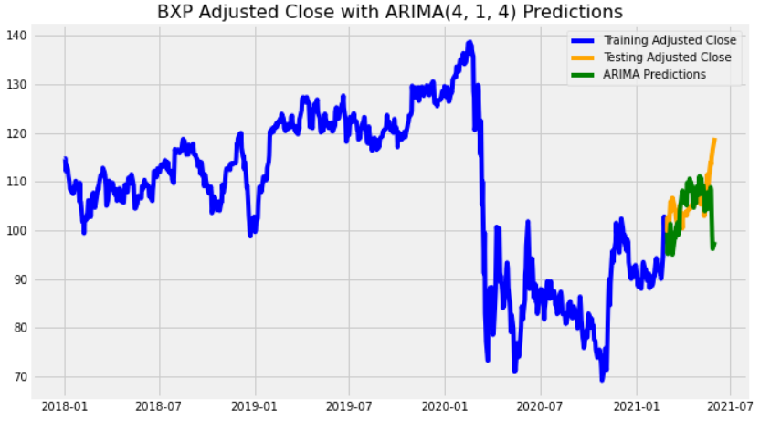
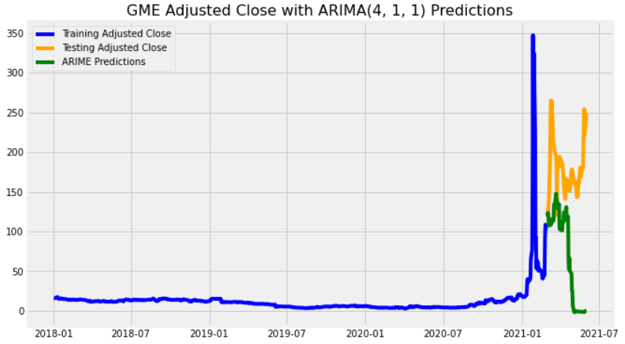
ARIMA Modeling: Results
It’s difficult to predict which tickers will perform well with ARIMA
After a short amount of time ARIMA quickly gets worse

Slide 8
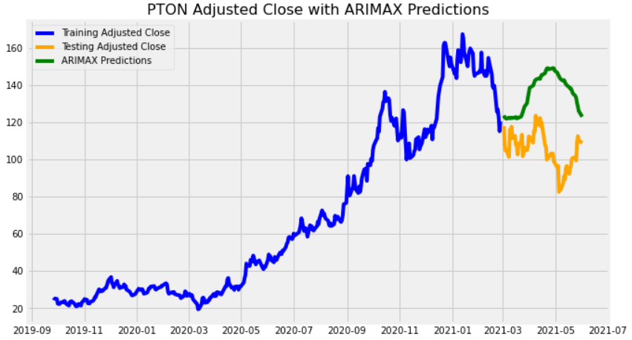
ARIMA w/ Exogeneous Variable Modeling
ARIMAX makes trend score available as a weighted input (aka X variable)
ARIMAX does not directly model/predict trend score, unlike VAR (to be covered later)

Slide 9
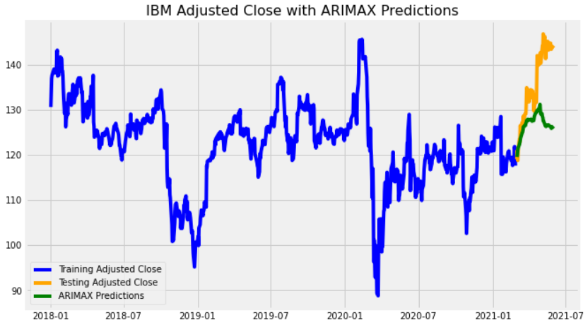
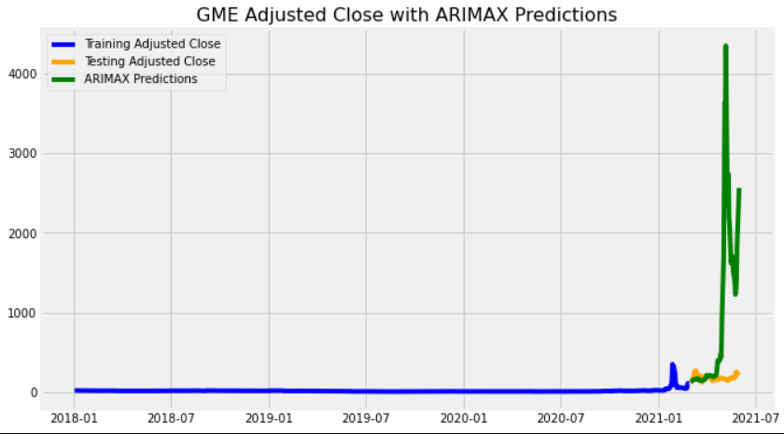
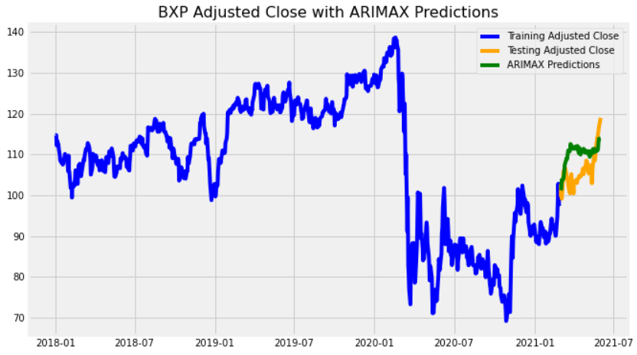
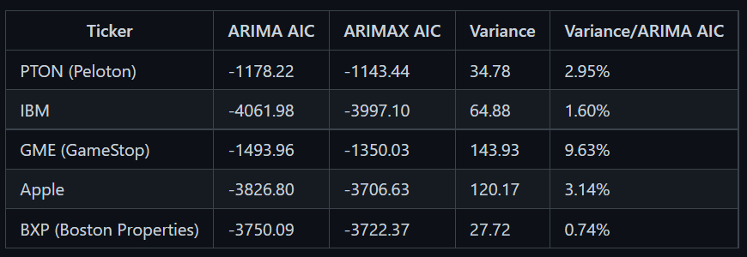

ARIMAX Modeling: Results
ARIMAX tended to predict the same shape regardless of ticker

Slide 10
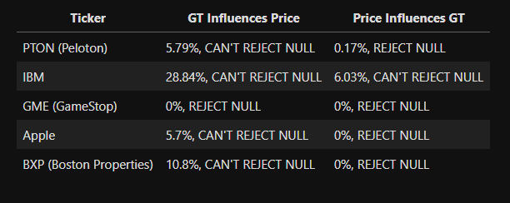
Granger’s Causality Test
My hypothesis is that the Google Trends time series influences the stock price time series (and vice versa)
The Granger’s Causality Test checks the null hypothesis that the past values of X do not influence Y
If the P-values returned by the test are < 5%, we can reject the null

Slide 11
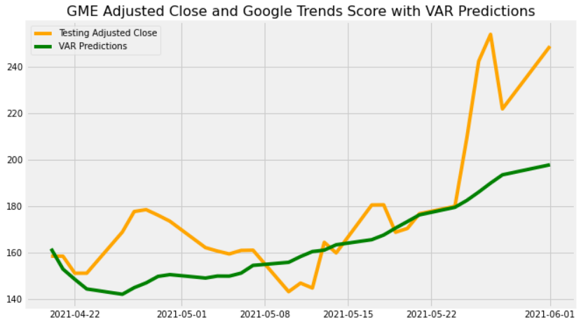
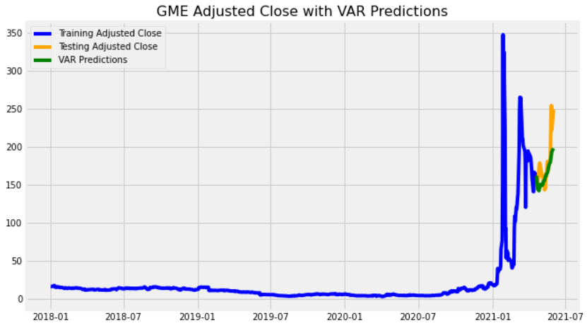
Vector Autoregression (VAR) Modeling
VAR assumes that multiple time series in a system influence each other
VAR’s ability to predict trend score could make it stronger than ARIMAX

Slide 12
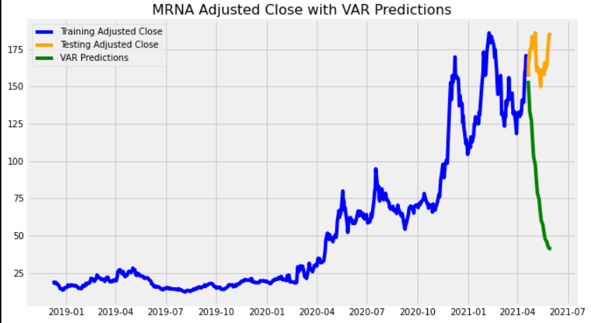
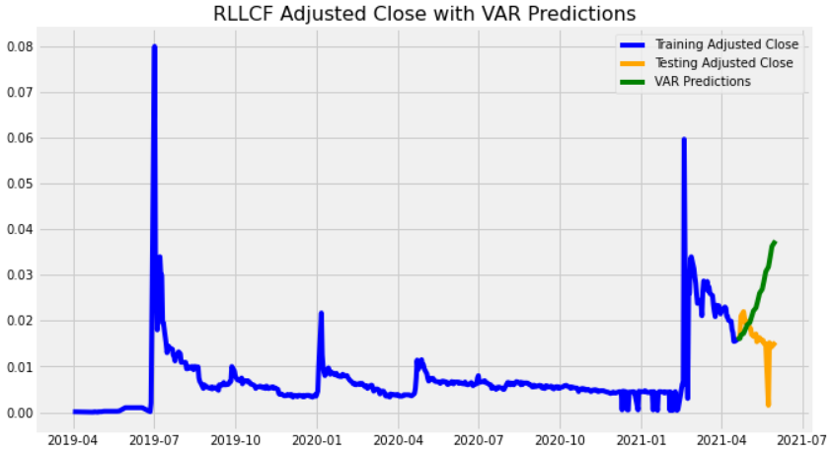
Vector Autoregression (VAR) Results
These were the first two stocks I found that also passed the Granger’s Causation Test
VAR performed very badly for these two, so VAR’s good fit on GME may have been luck

Slide 13
Outside Research

Slide 14
Google Trends for Investor Sentiment Analysis
Construct Sentiment Index Based on Google Trends
Sentiment Index Bearish?
Sentiment Index Bullish?
Buy Consumer Staples
Buy Consumer Discretionary
Harrison Schwartz of Seeking Alpha constructed an investor sentiment index using Google Trends
Schwartz used this index to create an algorithm which performed better in simulations than the S&P 500

Slide 15
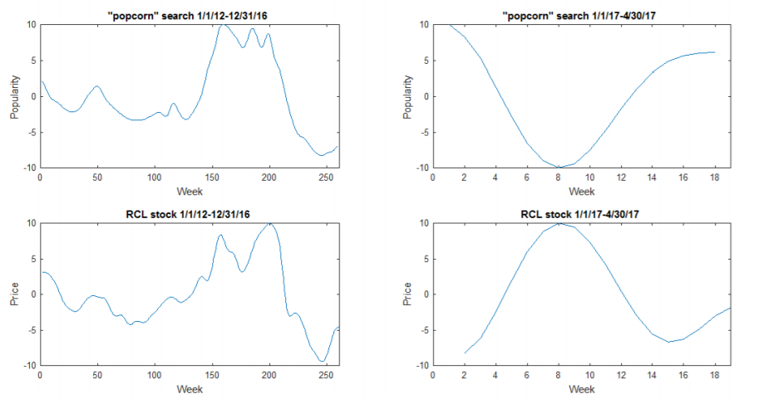
Correlation Between Other Trend Scores and Stock Price
Dartanyon Shivers of UCSD wrote about using selected keywords to predict stock price movement
Some stocks will temporarily correlate with a words’ trend score, but the correlation usually ends quickly

Slide 16
Conclusion
The usefulness of Google Trends for predicting stock prices is uncertain
ARIMA was better than my models that used trend score (for most tickers)
Granger’s Causality Test indicates that trend score influences stock price for some tickers
Outside research says that Google Trends can be effective as a market sentiment indicator

Slide 17
Next Steps
Improve Model Accuracy
Differences between model scores could be due to human error
Investigate using Google Trends for a trading algorithm
One concept: Buy stocks when their trend score is high, sell when it is low
Test and score models on a shorter prediction time frame
Some stock modeling tries to predict only a few days out

